Slide 1

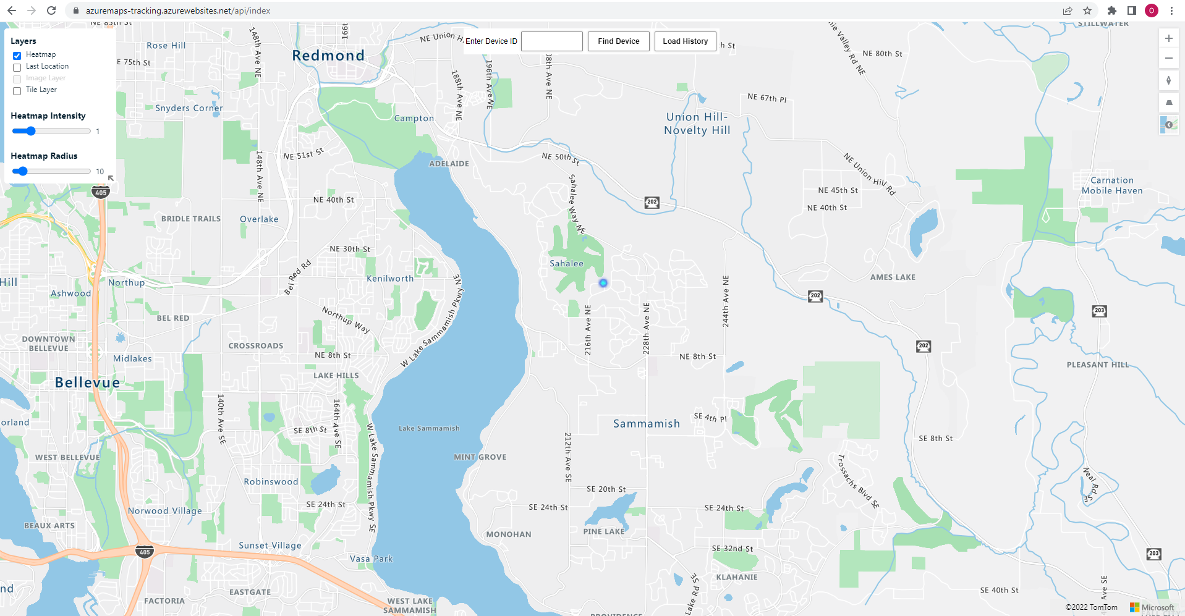
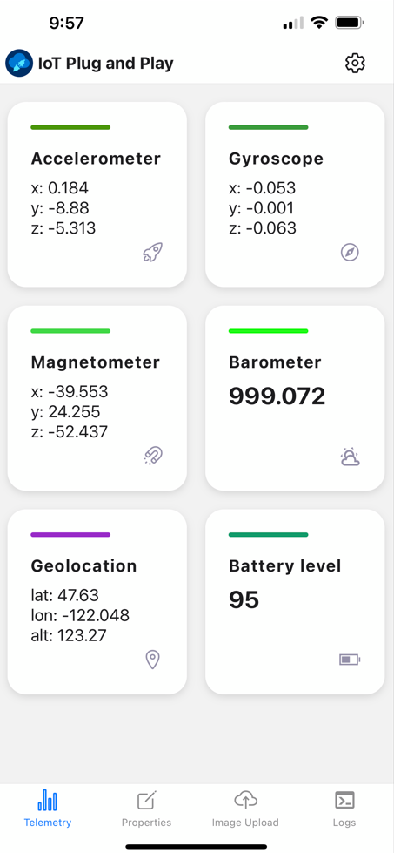







Azure Maps Real Time Tracking Demo – Solution Architecture
Management & Business Integration
Web Browser
Devices
Function App
Warm Path
Ingestion & Provisioning
Index
notification
negotiate
processdata
MQTT
Blob Storage
IoT Hub
IoT Plug and Play App
Azure Maps
Event
Hubs
Web PubSub
WebSocket
WebSocket
Warm Path
Azure Data Explorer
Power BI

